Slide 1
IMPASSE CONDITION

Slide 2
1
question

Slide 3
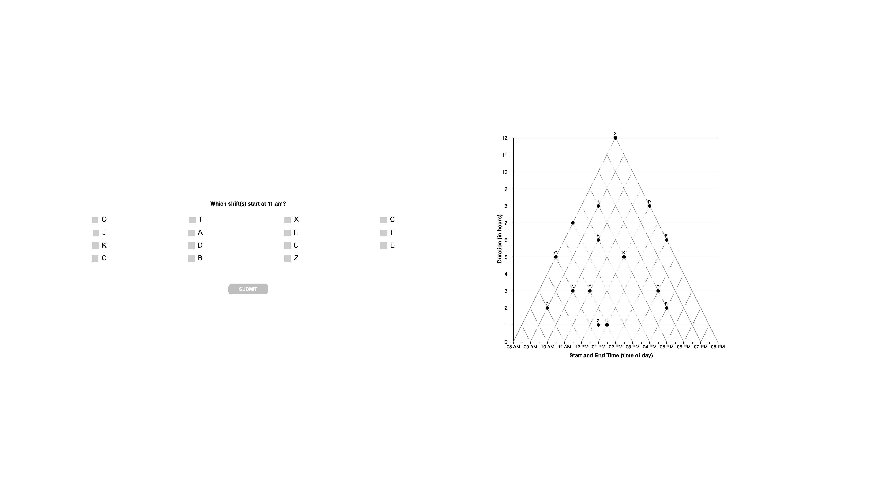

Slide 4
1
interpretations

Slide 6
1
unknown

Slide 8
2
question

Slide 9
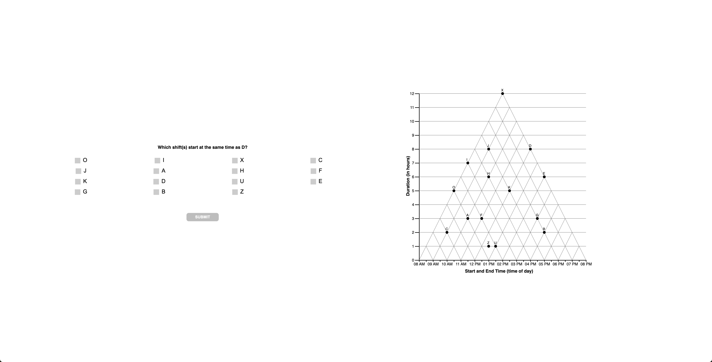

Slide 10
2
interpretations

Slide 12
2
unknown

Slide 13
3
question

Slide 14


Slide 15
3
interpretations

Slide 17
3
unknown

Slide 18
4
question

Slide 19
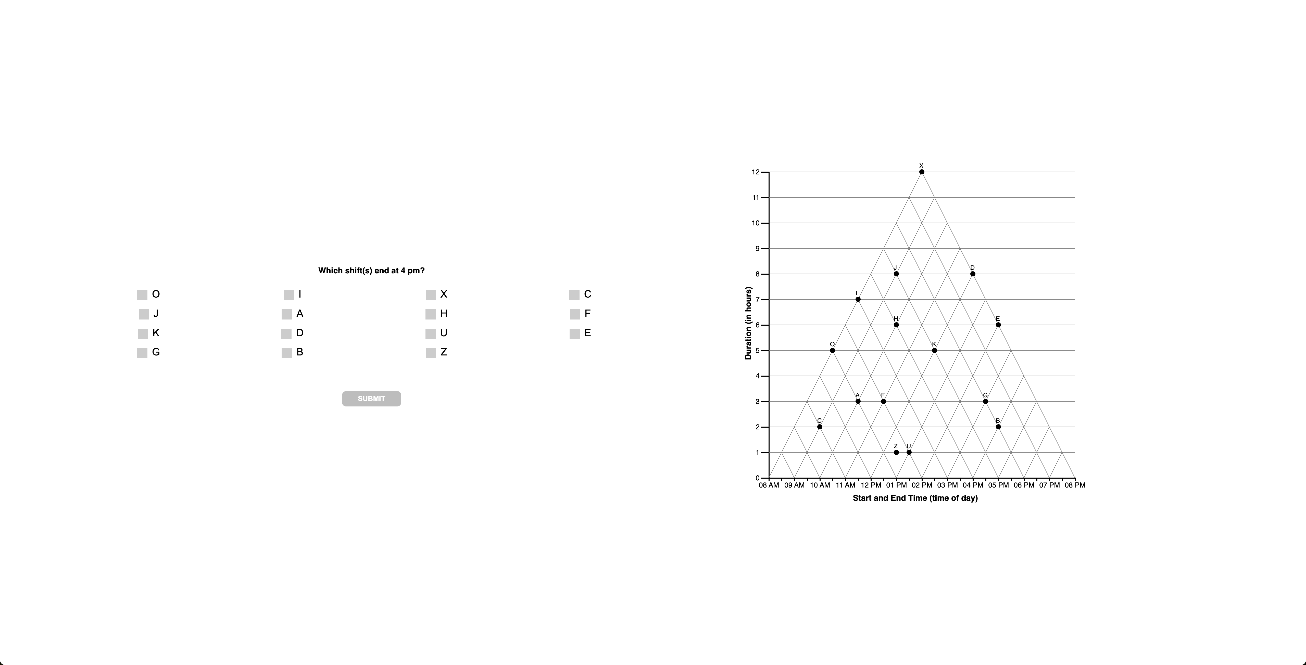

Slide 20
4
interpretations

Slide 22
4
unknown

Slide 23
5
question

Slide 24
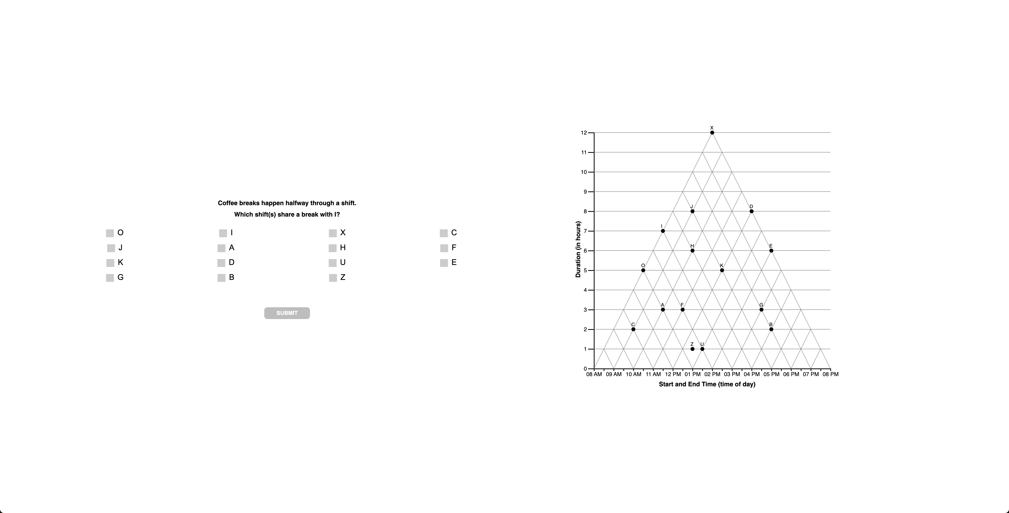

Slide 25
5
interpretations

Slide 27
5
unknown

